Slide 1

CHAPTER 2
THE LOGIC OF COMPOUND STATEMENTS
Copyright © Cengage Learning. All rights reserved.

Slide 2

2.1
Logical Form and Logical Equivalence
Copyright © Cengage Learning. All rights reserved.

Slide 3
Logical Form and Logical Equivalence
An argument is a sequence of statements aimed at demonstrating the truth of an assertion.
The assertion at the end of the sequence is called the conclusion, and the preceding statements are called premises.

Slide 4
Logical Form and Logical Equivalence
In logic, the form of an argument is distinguished from its content. Logical analysis won’t help you determine the intrinsic merit of an argument’s content, but it will help you analyze an argument’s form to determine whether the truth of the conclusion follows necessarily from the truth of the premises.
For this reason logic is sometimes defined as the science of necessary inference or the science of reasoning.

Slide 5
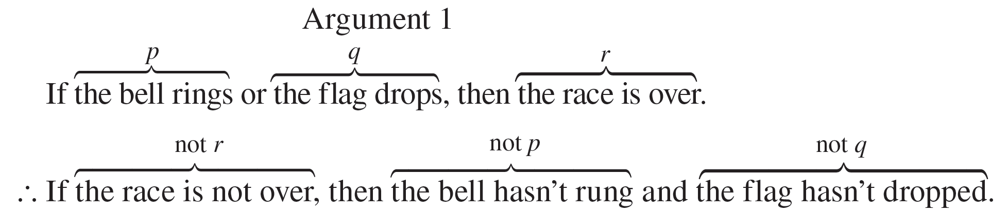
Logical Form and Logical Equivalence
Consider the following two arguments. They have very different content but their logical form is the same. To help make this clear, we use letters like p, q, and r to represent component sentences; we let the expression “not p” refer to the sentence “It is not the case that p”; and we let the symbol ∴ stand for the word “therefore.”

Slide 6
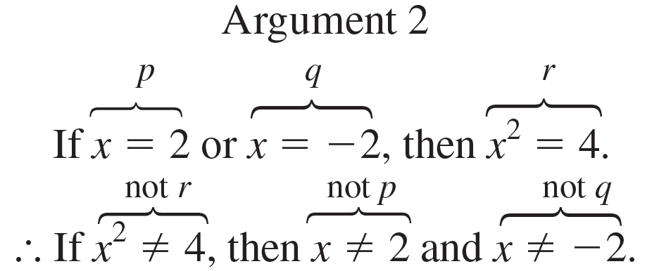
Logical Form and Logical Equivalence
The common form of the arguments is
If p or q, then r.
∴ If not r, then not p and not q.

Slide 7

Example 2.1.1 – Identifying Logical Form
Fill in the blanks below so that argument (b) has the same form as argument (a). Then represent the common form of the arguments using letters to stand for component sentences.
a. If Jane is a math major or Jane is a computer science major, then Jane will take Math 150. Jane is a computer science major. Therefore, Jane will take Math 150.
b. If logic is easy or
I will study hard. Therefore, I will get an A in this course.

Slide 8
Example 2.1.1 – Solution
a. I (will) study hard.
b. I will get an A in this course.
Common form: If p or q, then r.
q.
Therefore, r.

Slide 9
Statements

Slide 10
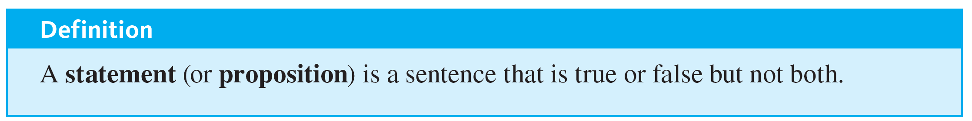

Statements
For example, “Two plus two equals four” and “Two plus two equals five” are both statements, the first because it is true and the second because it is false. On the other hand, the truth or falsity of
depends on the value of x. For some values of x, it is true (x = 3 and x = −3), whereas for other values it is false.

Slide 11
Statements
Similarly, the truth or falsity of
x + y > 0
depends on the values of x and y. For instance, when x = −1 and y = 2 it is true, whereas when x = −1 and y = 1 it is false.

Slide 12
Compound Statements

Slide 13




Compound Statements
We now introduce three symbols that are used to build more complicated logical expressions out of simpler ones. The symbol
denotes not, ∧ denotes and, and ∨ denotes or.
Given a statement p, the sentence
is read “not p” or “It is not the case that p.” In some computer languages the symbol
is used in place of

Slide 14
Compound Statements
In expressions that include the symbol
as well as ∧ or ∨, the order of operations specifies that
is performed first.
For instance,
p ∧ q = (
p) ∧ q. In logical expressions, as in ordinary algebraic expressions, the order of operations can be overridden through the use of parentheses.

Slide 15
Compound Statements
(p ∧ q) represents the negation of the conjunction of p and q. In this, as in most treatments of logic, the symbols ∧ and ∨ are considered coequal in order of operation, and an expression such as p ∧ q ∨ r is considered ambiguous.
This expression must be written as either (p ∧ q) ∨ r or p ∧ (q ∨ r) to have meaning.
Thus

Slide 16
Example 2.1.2 – Translating from English to Symbols: But and Neither-Nor
Write each of the following sentences symbolically, letting
h = “It is hot” and s = “It is sunny.”
a. It is not hot but it is sunny.
b. It is neither hot nor sunny.

Slide 17
Example 2.1.2 – Solution
a. The given sentence is equivalent to “It is not hot and it is sunny,” which can be written symbolically as
h ∧ s.
b. To say it is neither hot nor sunny means that it is not hot and it is not sunny. Therefore, the given sentence can be written symbolically as
s.
h ∧

Slide 18
Example 2.1.3 – And, Or, and Inequalities
Suppose x is a particular real number. Let p, q, and r symbolize “0 < x,” “x < 3,” and “x = 3,” respectively. Write the following inequalities symbolically:
a. x ≤ 3
b. 0 < x < 3
c. 0 < x ≤ 3

Slide 19
Example 2.1.3 – Solution
a. q ∨ r
b. p ∧ q
c. p ∧ (q ∨ r)

Slide 20
Truth Values

Slide 21
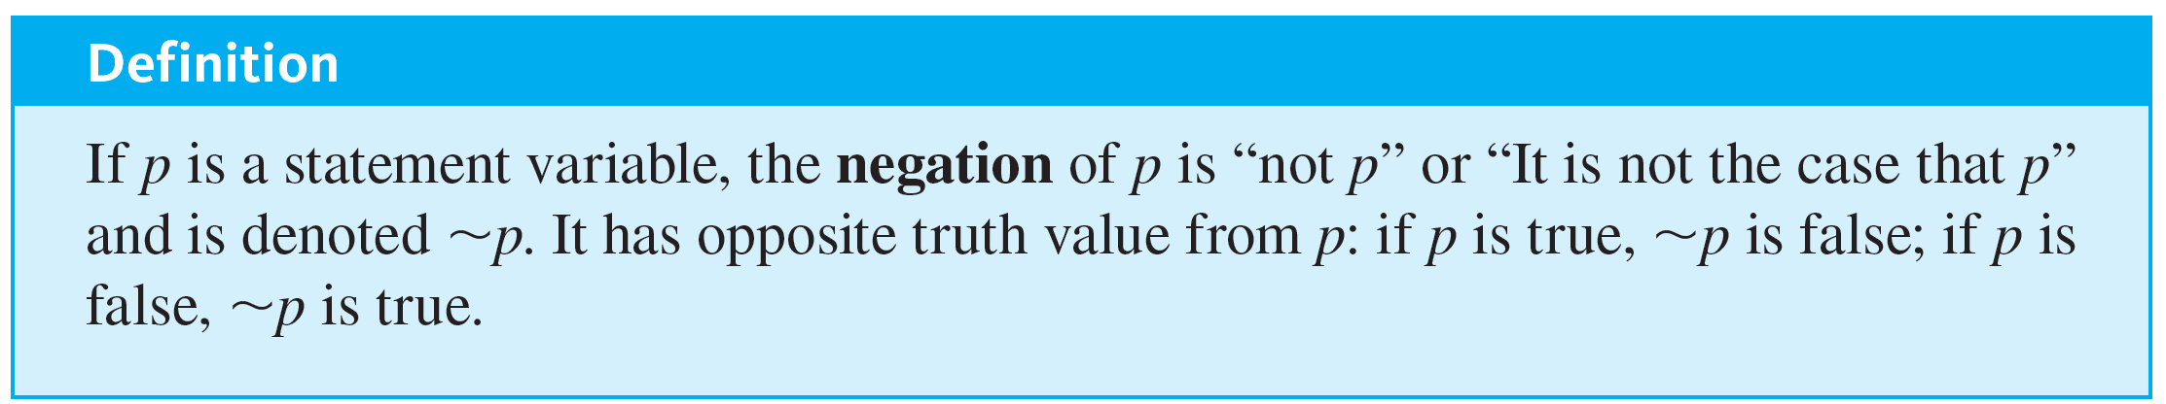
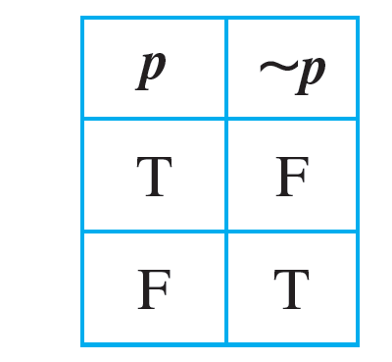
Truth Values
The truth values for negation are summarized in a truth table.

Slide 22
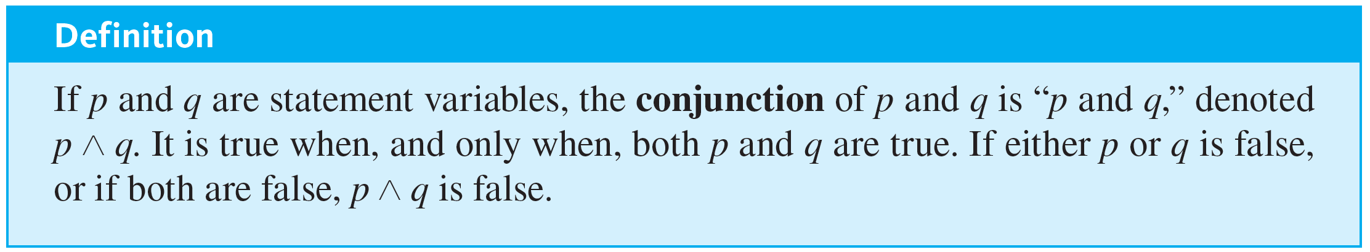
Truth Values
The truth values for conjunction can also be summarized in a truth table.

Slide 23
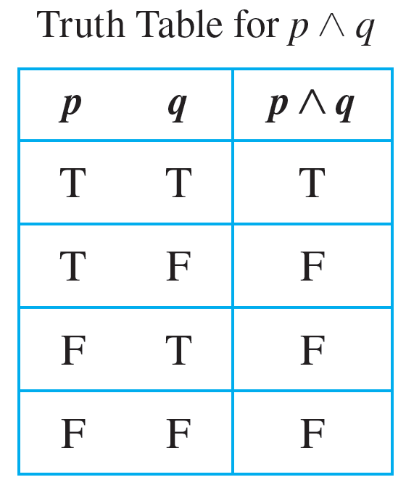
Truth Values
The table is obtained by considering the four possible combinations of truth values for p and q.

Slide 24
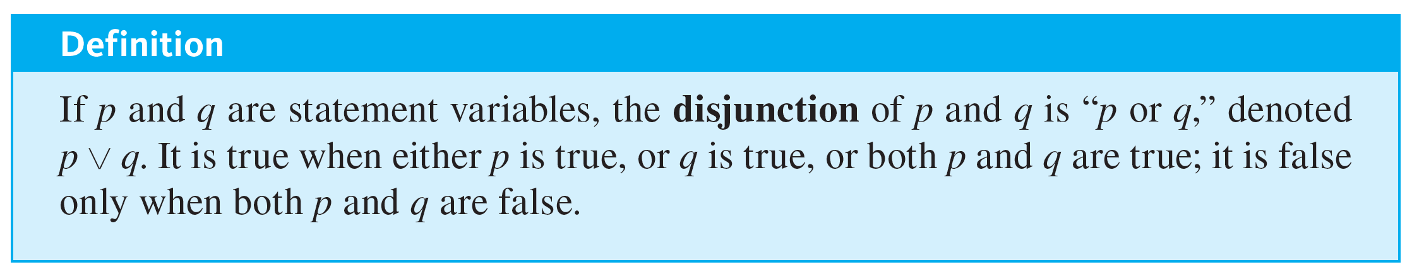
Truth Values
Each combination is displayed in one row of the table; the corresponding truth value for the whole statement is placed in the right-most column of that row. Note that the only row containing a T is the first one because an and statement is true only when both components are true.

Slide 25
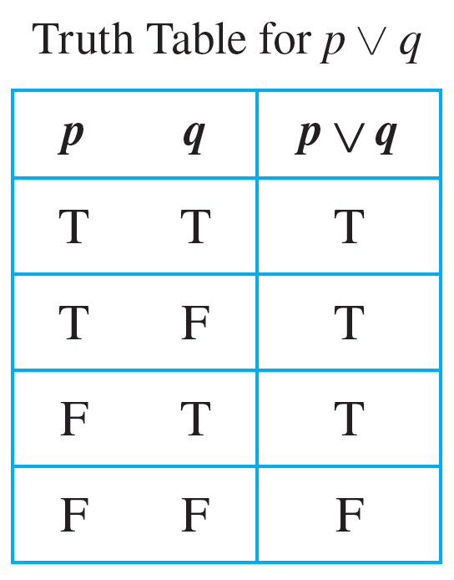
Truth Values
Here is the truth table for disjunction:

Slide 26
Evaluating the Truth of More General Compound Statements

Slide 27
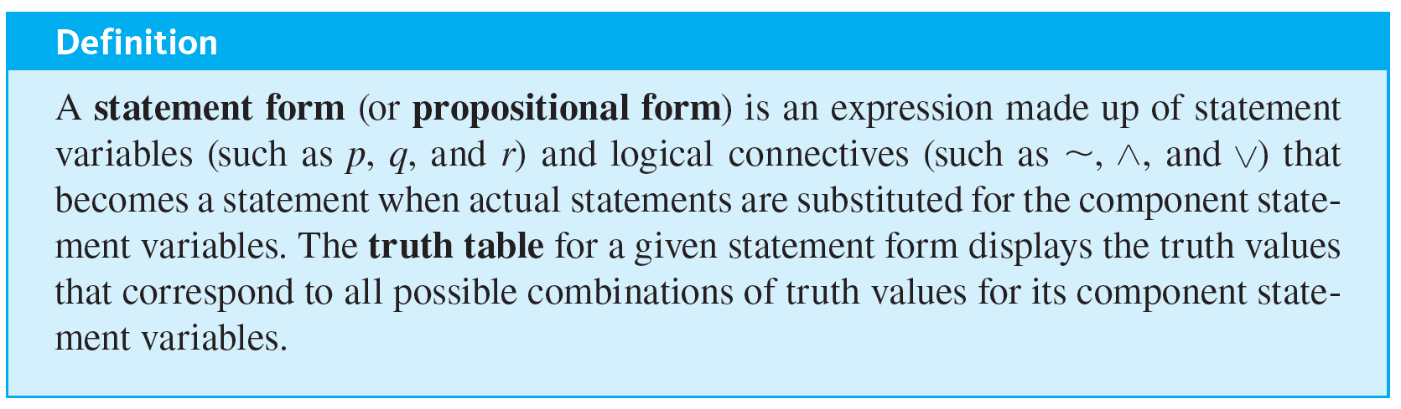
Evaluating the Truth of More General Compound Statements
Now that truth values have been assigned to
p, p ∧ q, and p ∨ q, consider the question of assigning truth values to more complicated expressions such as
p ∨ q, (p ∨ q) ∧
(p ∧ q), and (p ∧ q) ∨ r. Such expressions are called statement forms (or propositional forms).

Slide 28
Evaluating the Truth of More General Compound Statements
To compute the truth values for a statement form, follow rules similar to those used to evaluate algebraic expressions.
For each combination of truth values for the statement variables, first evaluate the expressions within the innermost parentheses, then evaluate the expressions within the next innermost set of parentheses, and so forth, until you have the truth values for the complete expression.

Slide 29
Example 2.1.4 – Truth Table for Exclusive Or
Construct the truth table for the statement form (p ∨ q) ∧
(p ∧ q). Note that when or is used in its exclusive sense, the statement “p or q” means “p or q but not both” or “p or q and not both p and q,” which translates into symbols as (p ∨ q) ∧
(p ∧ q).

Slide 30
Example 2.1.4 – Solution
Set up columns labeled p, q, p ∨ q, p ∧ q,
(p ∧ q), and (p ∨ q) ∧
(p ∧ q). Fill in the p and q columns with all the logically possible combinations of T’s and F’s. Then use the truth tables for ∨ and ∧ to fill in the p ∨ q and p ∧ q columns with the appropriate truth values. Next fill in the
(p ∧ q) column by taking the opposites of the truth values for p ∧ q.
For example, the entry for
(p ∧ q) in the first row is F because in the first row the truth value of p ∧ q is T.

Slide 31
Example 2.1.4 – Solution
continued
Finally, fill in the (p ∨ q) ∧
(p ∧ q) column by considering the truth values for an and statement together with the truth values for p ∨ q and
(p ∧ q).
Since an and statement is true only when both components are true and since rows 2 and 3 are the only two rows where both p ∨ q and
(p ∧ q) are true, put T in rows 2 and 3 and F in the remaining rows.

Slide 32
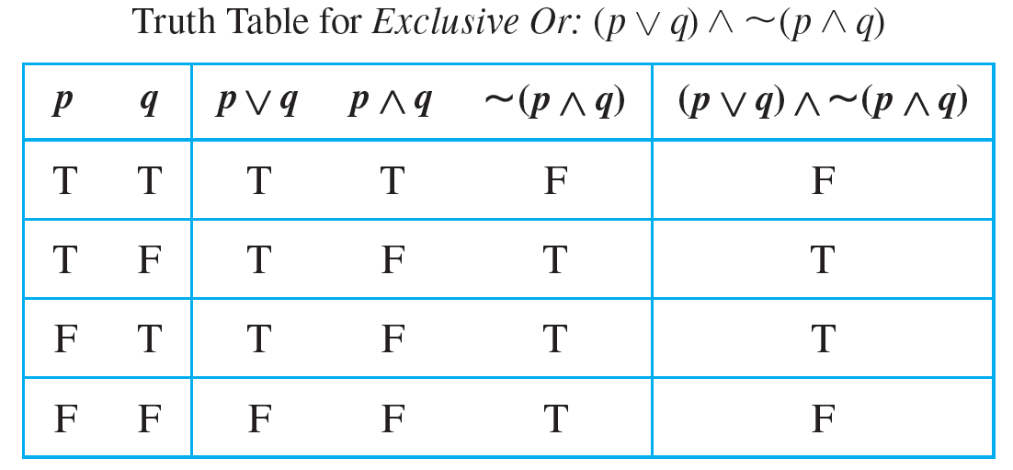
Example 2.1.4 – Solution
continued

Slide 33

Example 2.1.5 – Truth Table for
Construct a truth table for the statement form (p ∧ q) ∨
r.

Slide 34
Example 2.1.5 – Solution
Make columns headed p, q, r, p ∧ q,
r. Enter the eight logically possible combinations of truth values for p, q, and r in the three left-most columns. Then fill in the truth values for p ∧ q and for
r, and (p ∧ q) ∨
r.
Complete the table by considering the truth values for (p ∧ q) and for
r and the definition of an or statement.

Slide 35
Example 2.1.5 – Solution
continued
Since an or statement is false only when both components are false, the only rows in which the entry is F are the third, fifth, and seventh rows because those are the only rows in which the expressions p ∧ q and
r are both false.
The entry for all the other rows is T.

Slide 36
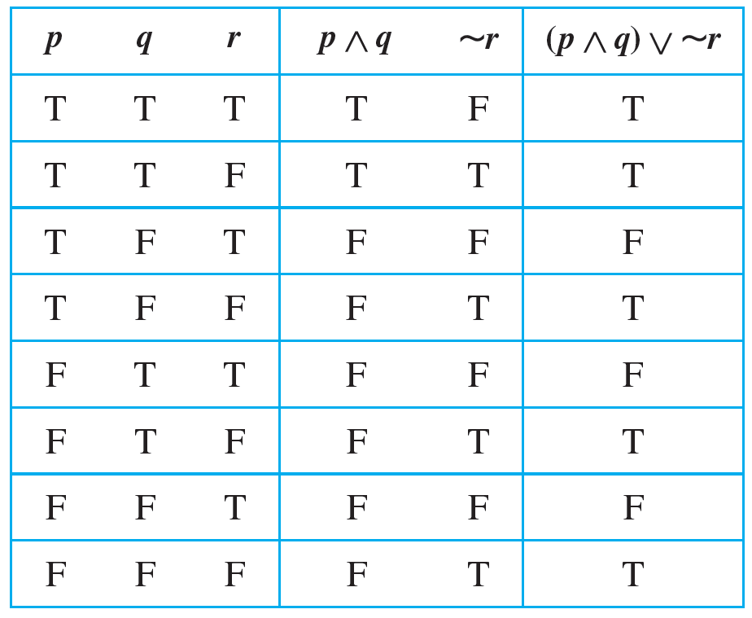
Example 2.1.5 – Solution
continued

Slide 37
Logical Equivalence

Slide 38
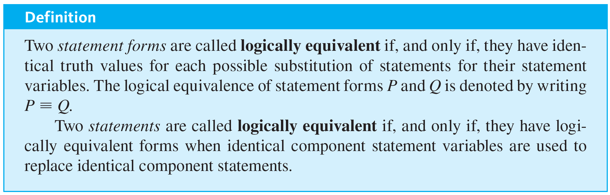
Logical Equivalence

Slide 39
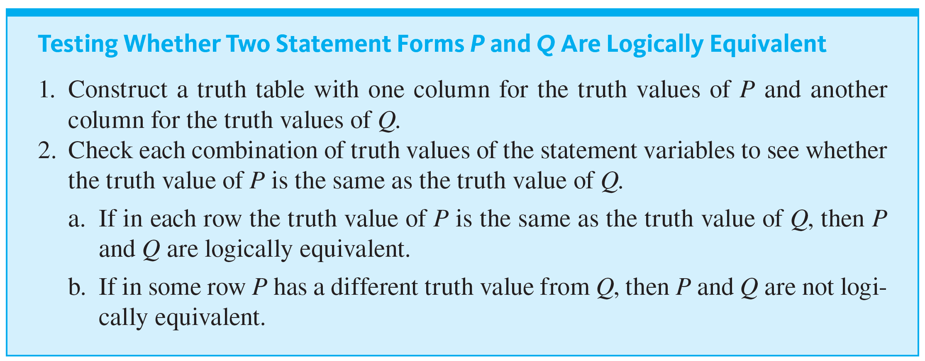
Logical Equivalence

Slide 40

Example 2.1.6 – Double Negative Property:
Construct a truth table to show that the negation of the negation of a statement is logically equivalent to the statement, annotating the table with a sentence of explanation.

Slide 41
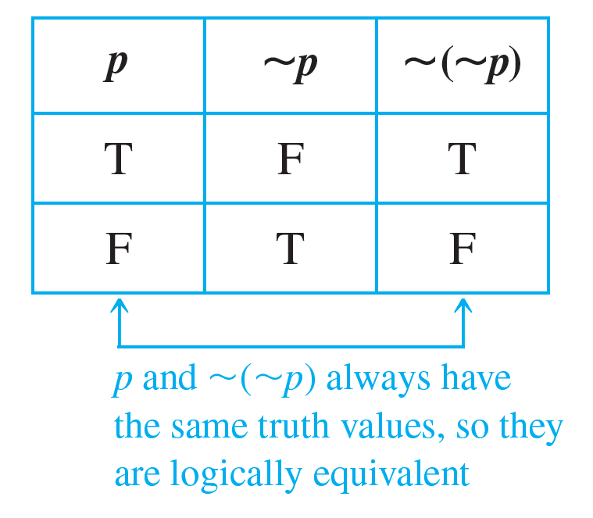
Example 2.1.6 – Solution

Slide 42
Example 2.1.7 – Showing Nonequivalence
q are not logically equivalent.
p ∧
Show that the statement forms
(p ∧ q) and

Slide 43
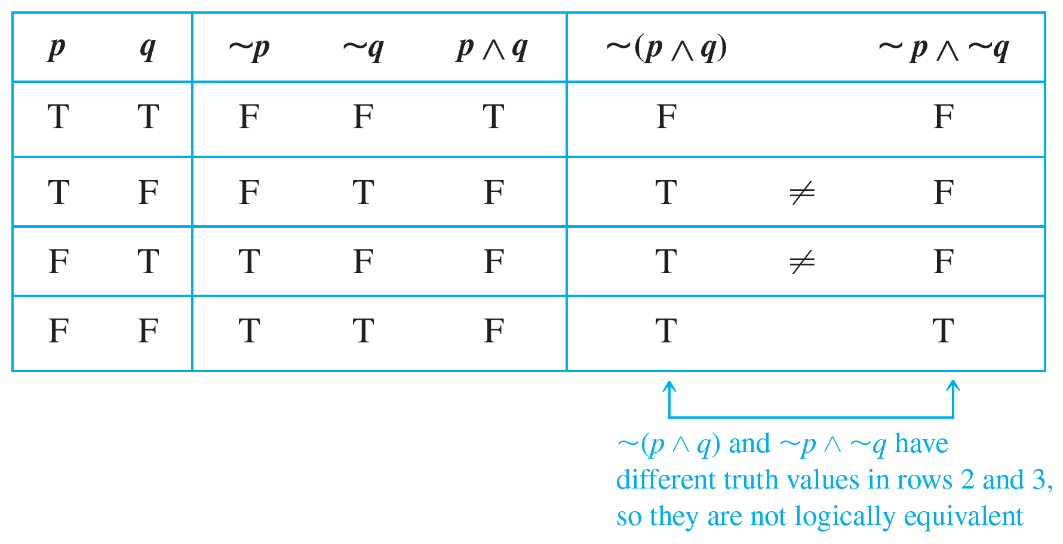
Example 2.1.7 – Solution
a. This method uses a truth table annotated with a sentence of explanation.

Slide 44
Example 2.1.7 – Solution
continued
b. This method uses an example to show that
(p ∧ q) and
p ∧
q are not logically equivalent. Let p be the statement “0 < 1” and let q be the statement “1 < 0.”
Then
(p ∧ q) is “It is not the case that both 0 < 1 and 1 < 0,”
which is true. On the other hand,
q is “0 ≮ 1 and 1 ≮ 0,”
which is false.
p ∧

Slide 45
Example 2.1.7 – Solution
continued
This example shows that there are concrete statements you can substitute for p and q to make one of the statement forms true and the other false.
Therefore, the statement forms are not logically equivalent.

Slide 46
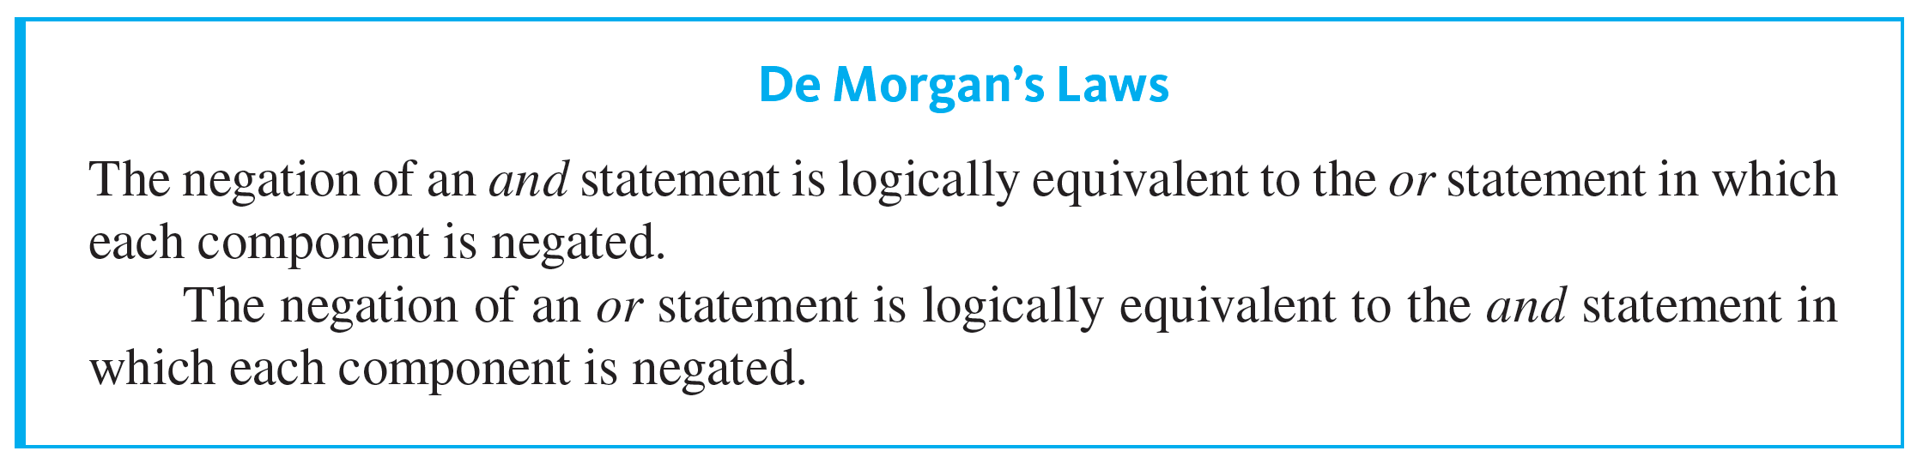
Logical Equivalence

Slide 47
Example 2.1.9 – Applying De Morgan’s Laws
Write negations for each of the following statements:
a. John is 6 feet tall and he weighs at least 200 pounds.
b. The bus was late or Tom’s watch was slow.

Slide 48
Example 2.1.9 – Solution
a. John is not 6 feet tall or he weighs less than 200 pounds.
b. The bus was not late and Tom’s watch was not slow.
Since the statement “neither p nor q” means the same as “
q,” an alternative answer for (b) is “Neither was the bus late nor was Tom’s watch slow.”
p and

Slide 49
Example 2.1.10 – Inequalities and De Morgan’s Laws
Use De Morgan’s laws to write the negation of −1 < x ≤ 4.

Slide 50
Example 2.1.10 – Solution
The given statement is equivalent to
−1 < x and x ≤ 4.
By De Morgan’s laws, the negation is
−1 ≮ x or x ≰ 4,
which is equivalent to
−1 ≥ x or x > 4.

Slide 51
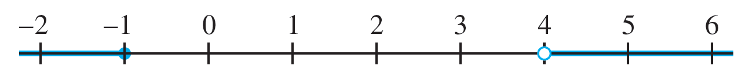
Example 2.1.10 – Solution
continued
Pictorially, if −1 ≥ x or x > 4, then x lies in the shaded region of the number line, as shown below.

Slide 52
Tautologies and Contradictions

Slide 53
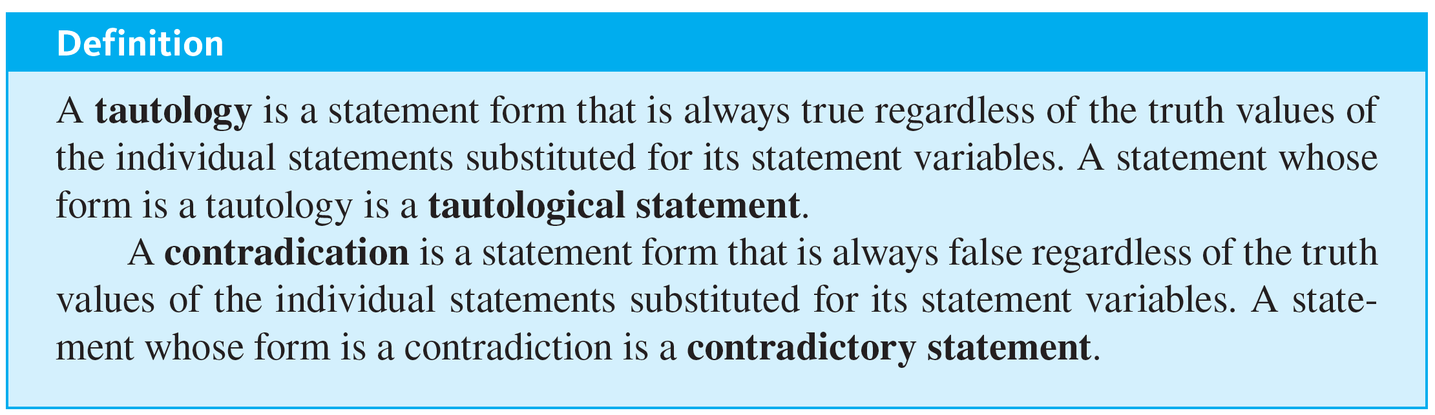
Tautologies and Contradictions

Slide 54
Example 2.1.12 – Tautologies and Contradictions
p is a tautology and that the statement form p ∧
Show that the statement form p ∨
p is a contradiction.

Slide 55
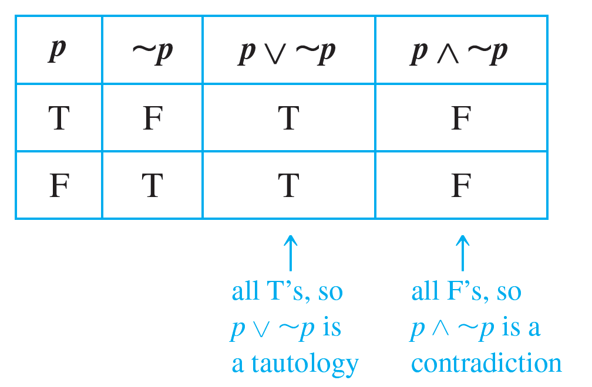
Example 2.1.12 – Solution

Slide 56

Example 2.1.13 – Logical Equivalence Involving Tautologies and Contradictions
If t is a tautology and c is a contradiction, show that

Slide 57
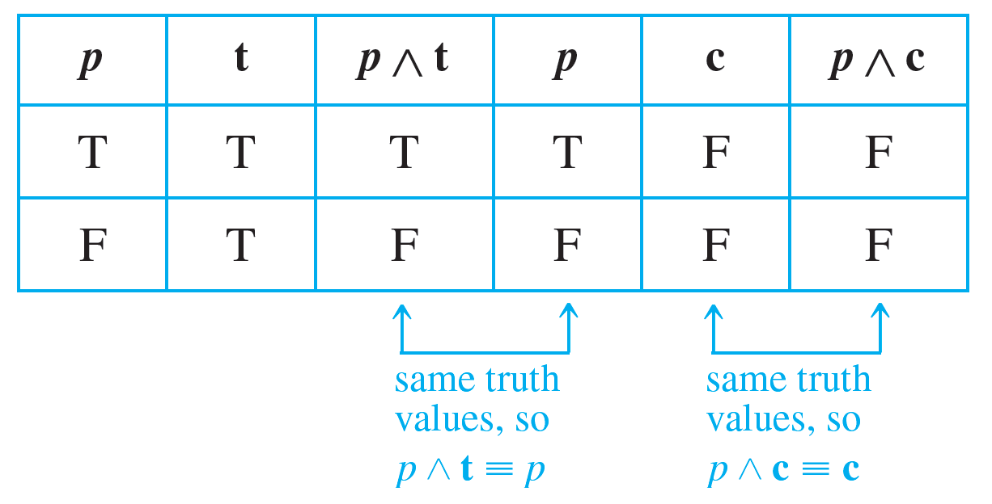
Example 2.1.13 – Solution

Slide 58
Summary of Logical Equivalences

Slide 59
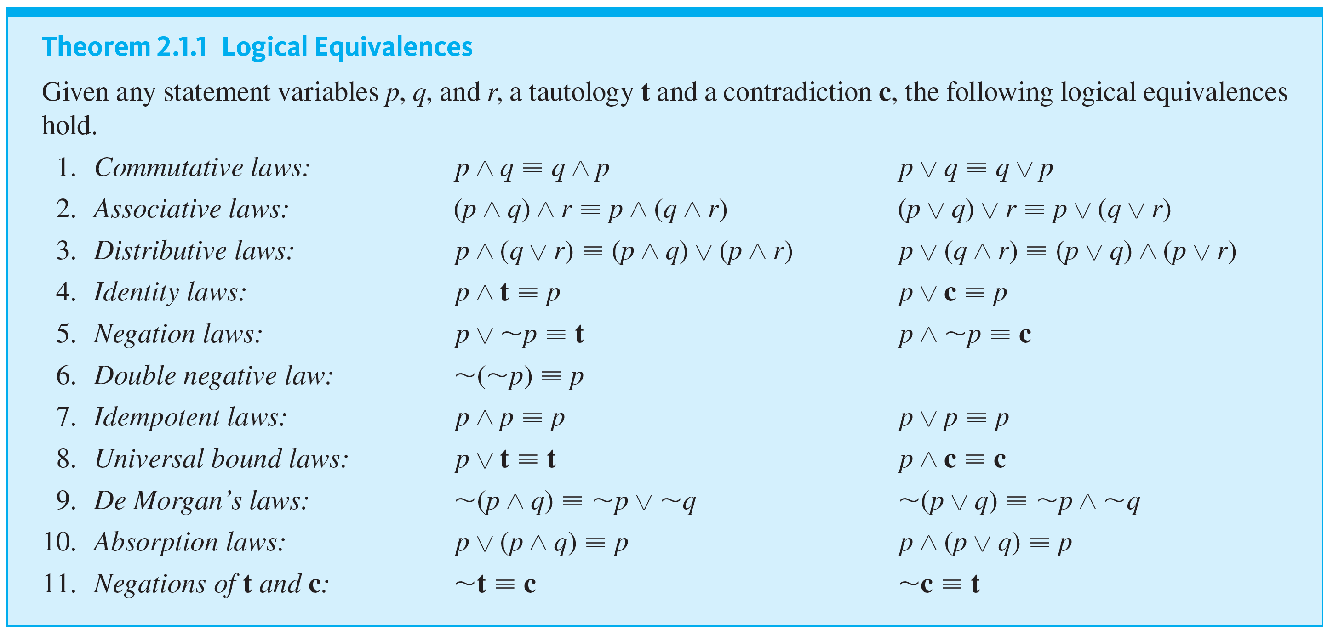
Summary of Logical Equivalences

Slide 60

Example 2.1.14 – Simplifying Statement Forms
Use Theorem 2.1.1 to verify the logical equivalence

Slide 61
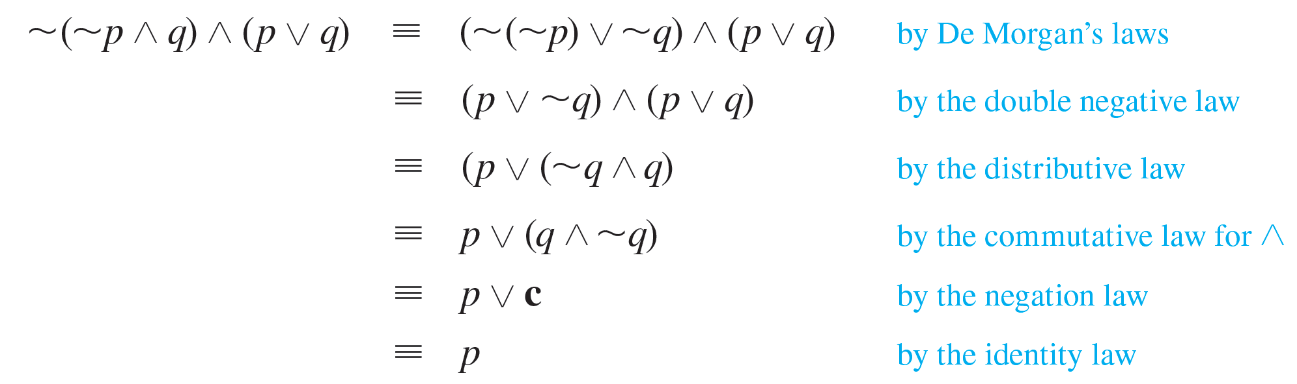
Example 2.1.14 – Solution
Use the laws of Theorem 2.1.1 to replace sections of the statement form on the left by logically equivalent expressions. Each time you do this, you obtain a logically equivalent statement form. Continue making replacements until you obtain the statement form on the right.

Slide 62
Example 2.1.14 – Solution
continued

